Slide 1

European Soccer Database
PREDICT OVERALL RATING OF A PLAYER
MARCH 2018
PAPRI SAHA

Slide 2



Slide 3


AGENDA
Objective: Predicting player rating
Data processing and cleaning, Visualization
Model Built and Evaluation
Improvisation to Model

Slide 4

1
OBJECTIVE
Objectives of current project is:
1) Predicting “overall rating of players“ based on other 41 features
2) Prediction Problem
3) The given data set has following attributes (183978 rows and 42 columns)

Slide 5
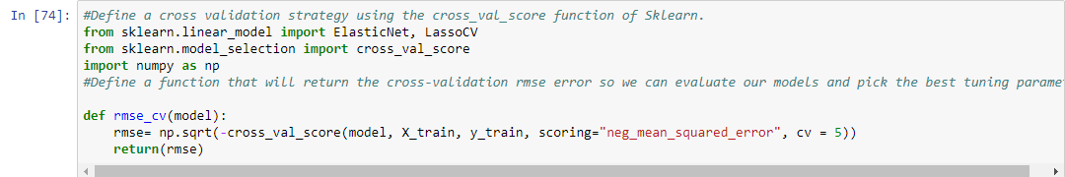
2
DATA PREPROCESSING
There are missing values in the original dataset.
”Mean” has been used to populate the missing values for numerical variables.One numerical varaible has been converted
to “categorical”
2) The given data set has following attributes (183978 rows and 42 features)
- Categorical Variables - 4
-Numerical Variables - 37)
- Label encoder has been used to handle the categorical variables
Used Random Forest ensemble model and selected top 20 features that contributes in the player rating
4) Wrote a custom “rmse_cv" function in python to re-use and find out roomt mean square based out of cross validation score

Slide 6
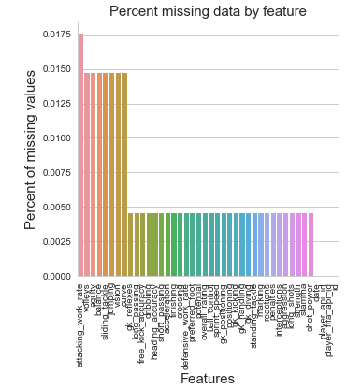
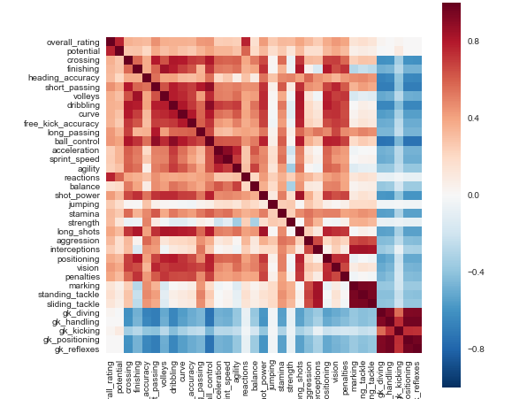
3
DATA VISUALIZATION
Some trends!

Slide 7
5
MODEL BUILT AND EVALUATION
1) Split into train (80%) and test (20%)
2) Used Cross validation score to get the rmse score
3) 2 Regression model and 1 ensemble model have been used
Algorithm | Train Accuracy | Test Accuracy | RMSE | R2
Linear Regression | 0.8417 | 0.8402 | 2.79 | 0.84
Lasso | 0.8417 | 0.8402 | 2.79 | 0.84
Random Forest | 0.997 | 0.995 | 0.82 | 0.99

Slide 8
6
IMPROVISATIONS TO MODELS WITH
TIME
Novel methods to Feature engineering viz. splitting looking at the patterns ,dropping unwanted columns can be improved upon
The Domain knowledge would have made more accurate models

